Slide 1

Diffusion
MTH 564 – Mathematical Modeling

Slide 2
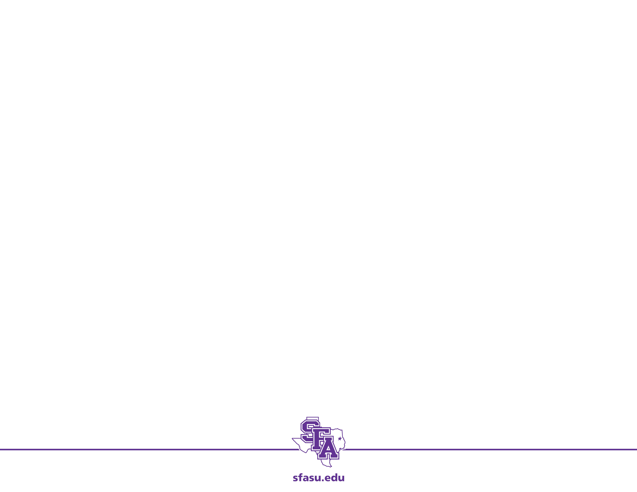
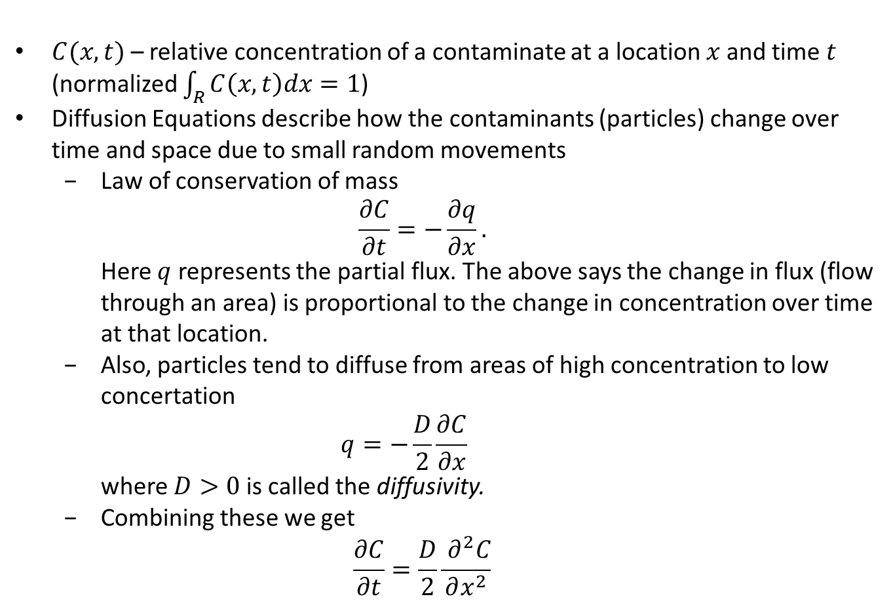
Fick’s Law
$C(x,t)$ – relative concentration of a contaminate at a location $x$ and time $t$ (normalized $\int_{R}{C\left(x,t\right)dx=1}$)
Diffusion Equations describe how the contaminants (particles) change over time and space due to small random movements
Law of conservation of mass $\frac{∂C}{∂t}=−\frac{∂q}{∂x}.$ Here $q$ represents the partial flux. The above says the change in flux (flow through an area) is proportional to the change in concentration over time at that location.
Also, particles tend to diffuse from areas of high concentration to low concertation $q=−\frac{D}{2}\frac{∂C}{∂x}$ where $D>0$ is called the diffusivity.
Combining these we get $\frac{∂C}{∂t}=\frac{D}{2}\frac{{ ∂}^{2}C}{∂x^{2}}$

Slide 3
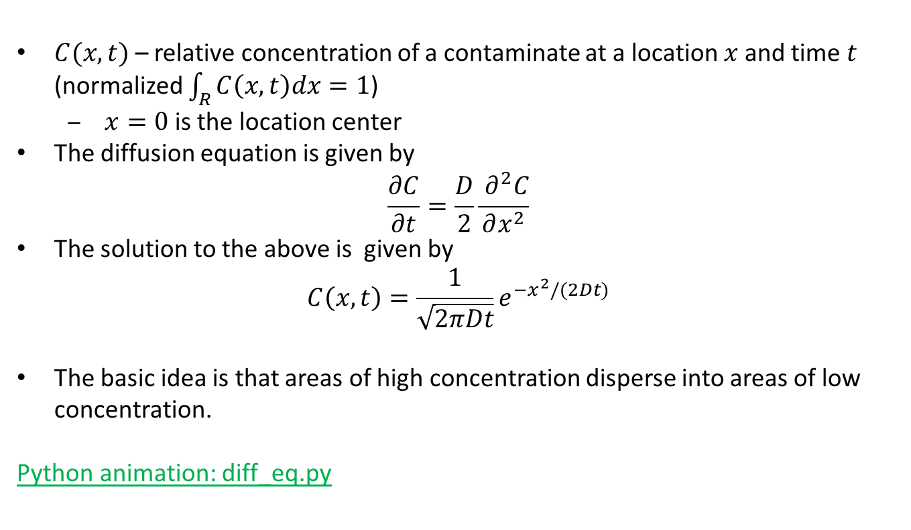
Fick’s Law
$C(x,t)$ – relative concentration of a contaminate at a location $x$ and time $t$ (normalized $\int_{R}{C\left(x,t\right)dx=1}$)
$x=0$ is the location center
The diffusion equation is given by
$$\frac{∂C}{∂t}=\frac{D}{2}\frac{{ ∂}^{2}C}{∂x^{2}}$$
The solution to the above is given by $C\left(x,t\right)=\frac{1}{\sqrt{2πDt}}e^{−x^{2}/(2Dt)}$
The basic idea is that areas of high concentration disperse into areas of low concentration.
Python animation: diff_eq.py

Slide 4
Problem
An accident at an industrial plant ten kilometers upwind of a small town releases an airborne pollutant. One hour after release, a toxic cloud 2000 meters long is headed toward the town at a wind speed of 3 kilometers per hour. The maximum concentration of the pollutant in the cloud is 20 times the safe level. What is the maximum concentration expected in town, when will it occur, and how long until the concentration of pollutant falls back below a safe level?

Slide 5
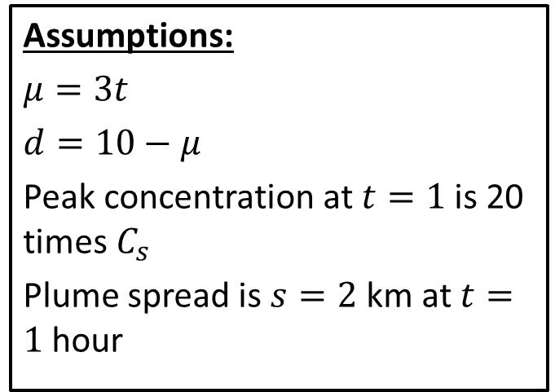
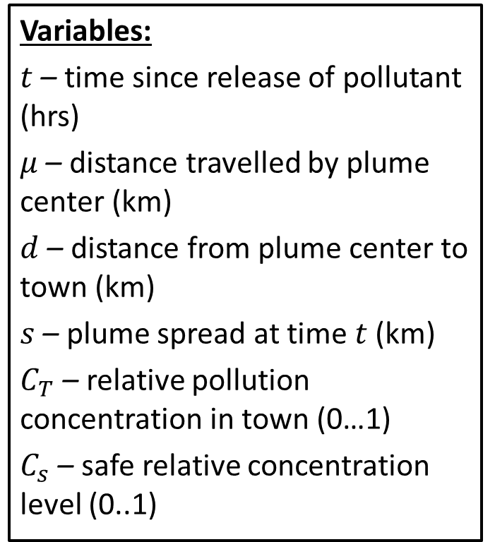
Step 1: Frame the problem
Variables:
$t$ – time since release of pollutant (hrs)
$μ$ – distance travelled by plume center (km)
$d$ – distance from plume center to town (km)
$s$ – plume spread at time $t$ (km)
$C_{T}$ – relative pollution concentration in town (0…1)
$C_{s}$ – safe relative concentration level (0..1)
Assumptions:
$μ=3t$
$d=10−μ$
Peak concentration at $t=1$is 20 times $C_{s}$
Plume spread is $s=2$ km at $t=1$ hour
Objective
Determine the maximum level of pollution in town, and the time until pollution falls back to safe levels.

Slide 6
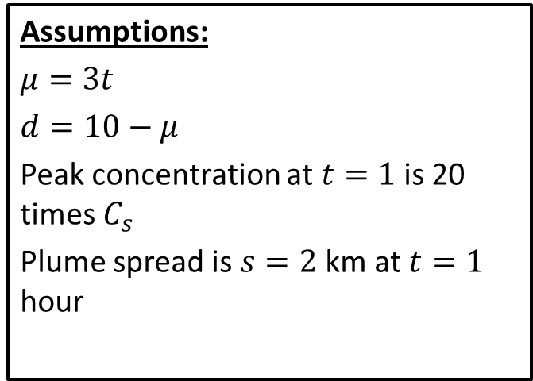
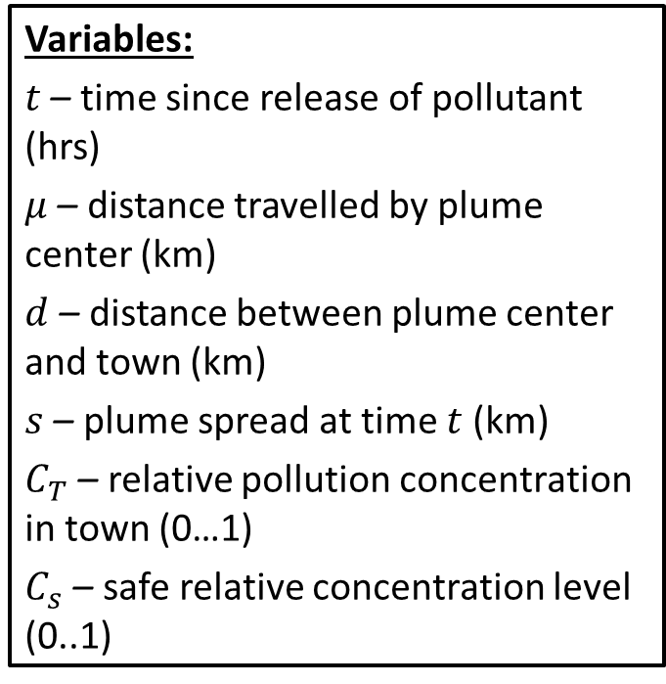
Step 2: Select the modeling approach
Variables:
$t$ – time since release of pollutant (hrs)
$μ$ – distance travelled by plume center (km)
$d$ – distance between plume center and town (km)
$s$ – plume spread at time $t$ (km)
$C_{T}$ – relative pollution concentration in town (0…1)
$C_{s}$ – safe relative concentration level (0..1)
Assumptions:
$μ=3t$
$d=10−μ$
Peak concentration at $t=1$is 20 times $C_{s}$
Plume spread is $s=2$ km at $t=1$ hour
Objective
Determine the maximum level of pollution in town , and the time until pollution falls back to safe levels.
Approach
We will use a diffusion model.

Slide 7
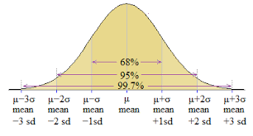
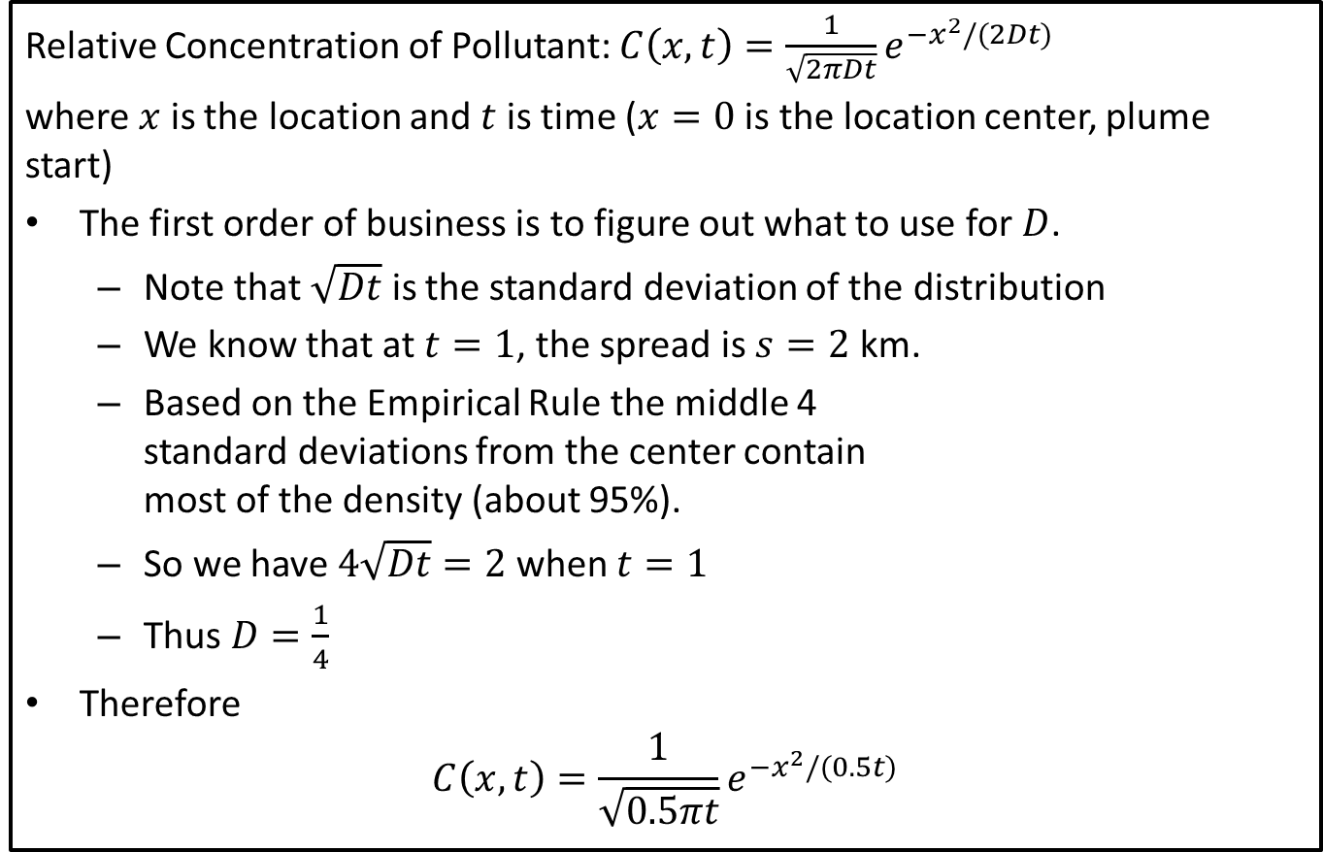
Step 3: Formulate the model
Relative Concentration of Pollutant: $C\left(x,t\right)=\frac{1}{\sqrt{2πDt}}e^{−x^{2}/(2Dt)}$
where $x$ is the location and $t$ is time ($x=0$ is the location center, plume start)
The first order of business is to figure out what to use for $D$.
Note that $\sqrt{Dt}$ is the standard deviation of the distribution
We know that at $t=1$, the spread is $s=2$ km.
Based on the Empirical Rule the middle 4 standard deviations from the center contain most of the density (about 95%).
So we have $4\sqrt{Dt}=2$ when $t=1$
Thus $D=\frac{1}{4}$
Therefore
$$C\left(x,t\right)=\frac{1}{\sqrt{0.5πt}}e^{−x^{2}/(0.5t)}$$

Slide 8
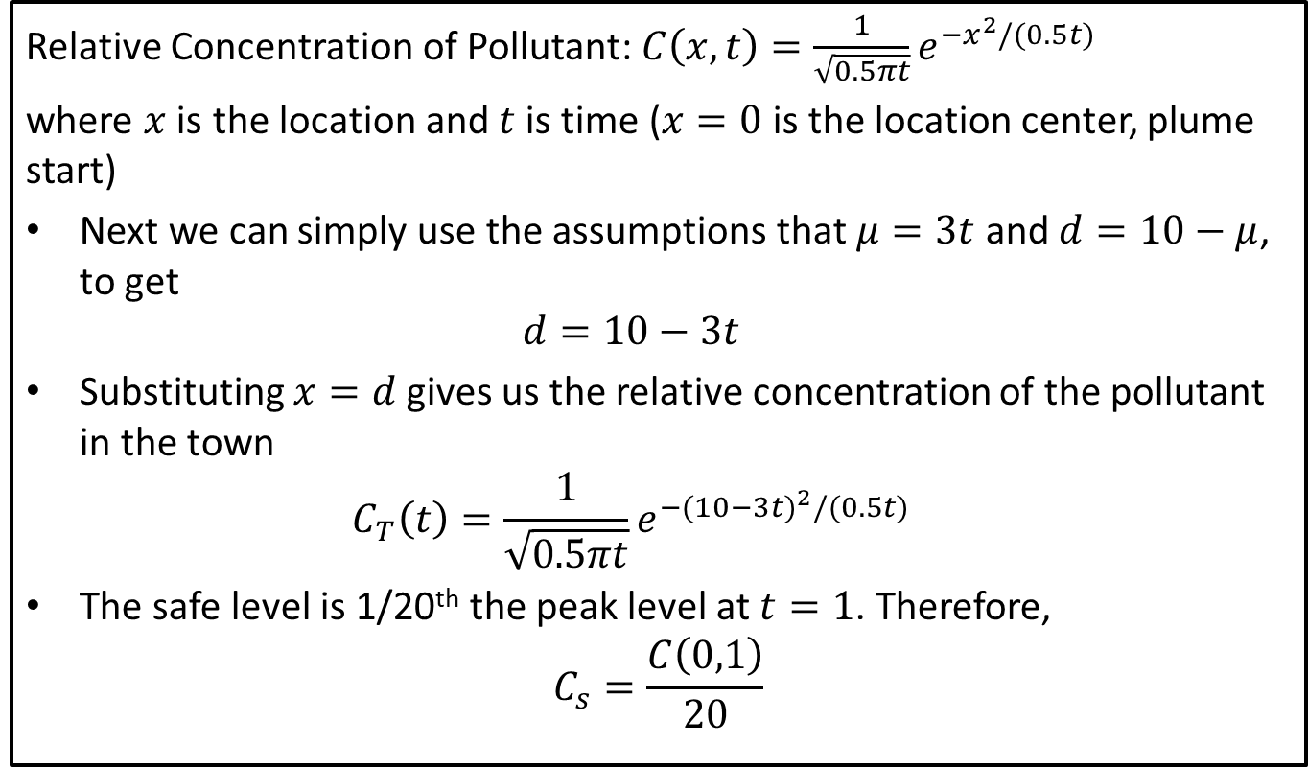
Step 3: Formulate the model
Relative Concentration of Pollutant: $C\left(x,t\right)=\frac{1}{\sqrt{0.5πt}}e^{−x^{2}/(0.5t)}$
where $x$ is the location and $t$ is time ($x=0$ is the location center, plume start)
Next we can simply use the assumptions that $μ=3t$ and $d=10−μ$, to get $d=10−3t$
Substituting $x=d$ gives us the relative concentration of the pollutant in the town $C_{T}\left(t\right)=\frac{1}{\sqrt{0.5πt}}e^{−{(10−3t)}^{2}/(0.5t)}$
The safe level is 1/20th the peak level at $t=1$. Therefore, $C_{s}=\frac{C\left(0,1\right)}{20}$

Slide 9
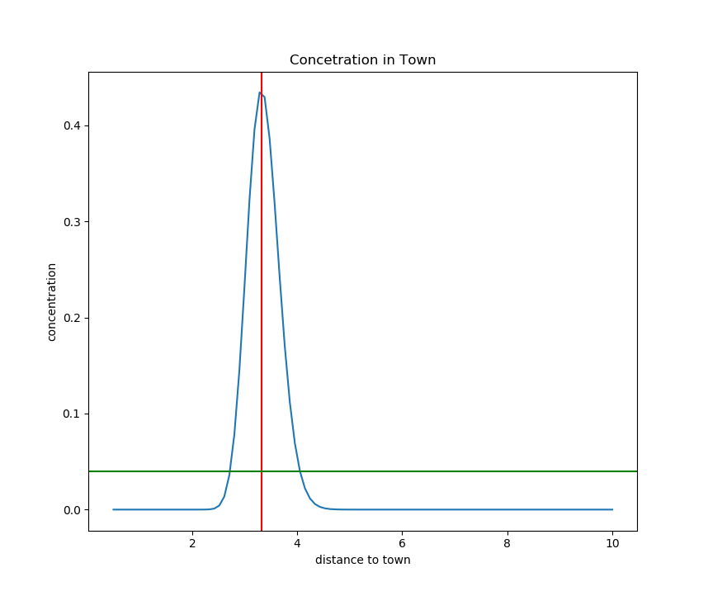
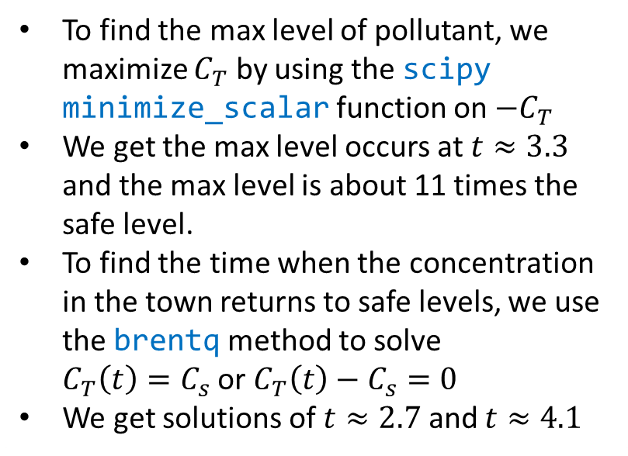
Step 4: Solve the Problem
Determine the maximum level of pollution in town, and the time until pollution falls back to safe levels.
To find the max level of pollutant, we maximize $C_{T}$ by using the scipy minimize_scalar function on ${−C}_{T}$
We get the max level occurs at $t≈3.3$ and the max level is about 11 times the safe level.
To find the time when the concentration in the town returns to safe levels, we use the brentq method to solve $C_{T}\left(t\right)=C_{s}$ or $C_{T}\left(t\right)−C_{s}=0$
We get solutions of $t≈2.7$ and $t≈4.1$
Notes:
See python file section1-1pig.py

Slide 10
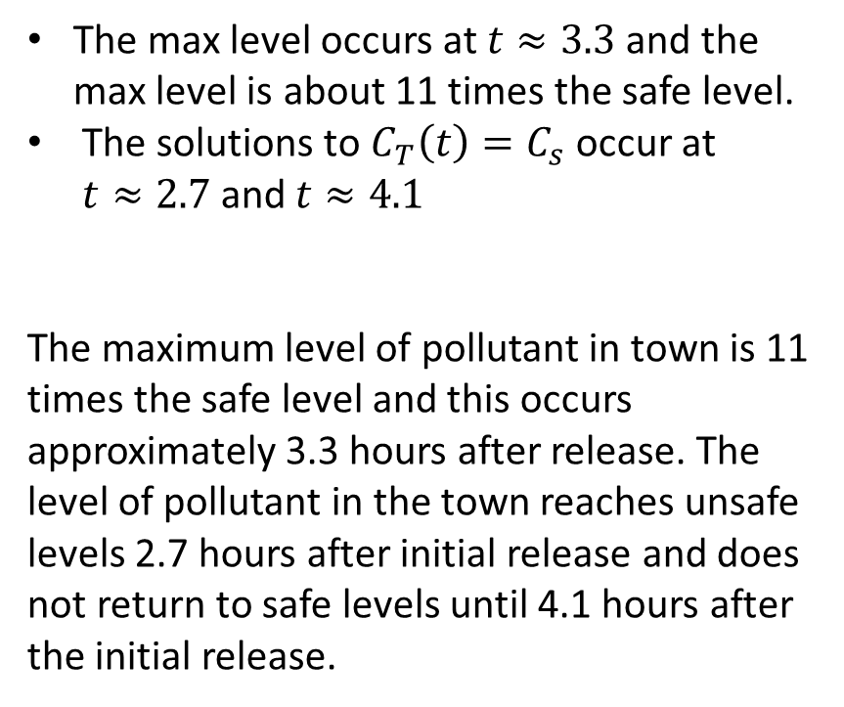
Step 5: Answer the question
Determine the maximum level of pollution in town, and the time until pollution falls back to safe levels.
The max level occurs at $t≈3.3$ and the max level is about 11 times the safe level.
The solutions to $C_{T}\left(t\right)=C_{s}$ occur at $t≈2.7$ and $t≈4.1$
The maximum level of pollutant in town is 11 times the safe level and this occurs approximately 3.3 hours after release. The level of pollutant in the town reaches unsafe levels 2.7 hours after initial release and does not return to safe levels until 4.1 hours after the initial release.
Notes:
See python file section1-1pig.py

Slide 11
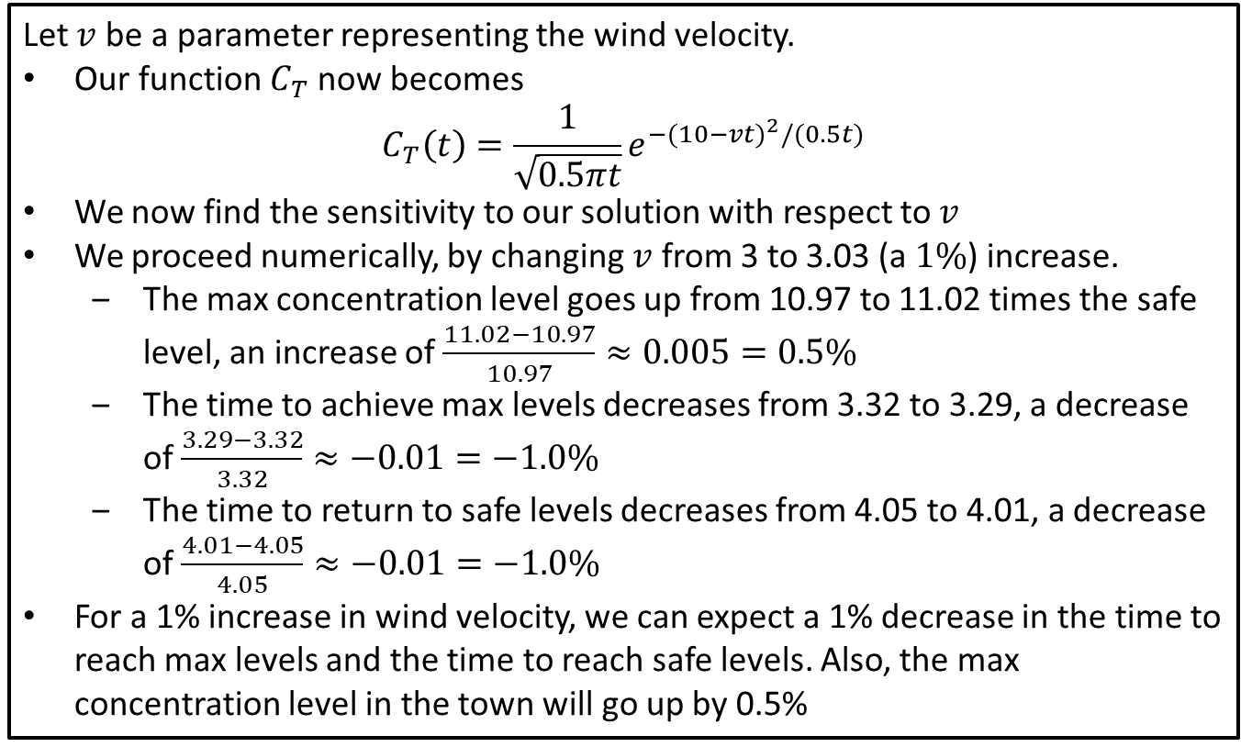
Sensitivity Analysis: Wind Velocity
Let $v$ be a parameter representing the wind velocity.
Our function $C_{T}$ now becomes $C_{T}\left(t\right)=\frac{1}{\sqrt{0.5πt}}e^{−{(10−vt)}^{2}/(0.5t)}$
We now find the sensitivity to our solution with respect to $v$
We proceed numerically, by changing $v$ from 3 to 3.03 (a $1\%$) increase.
The max concentration level goes up from 10.97 to 11.02 times the safe level, an increase of $\frac{11.02−10.97}{10.97}≈0.005=0.5\%$
The time to achieve max levels decreases from 3.32 to 3.29, a decrease of $\frac{3.29−3.32}{3.32}≈−0.01=−1.0\%$
The time to return to safe levels decreases from 4.05 to 4.01, a decrease of $\frac{4.01−4.05}{4.05}≈−0.01=−1.0\%$
For a 1% increase in wind velocity, we can expect a 1% decrease in the time to reach max levels and the time to reach safe levels. Also, the max concentration level in the town will go up by 0.5%
Notes:
See python file section1-1pig.py

Slide 12
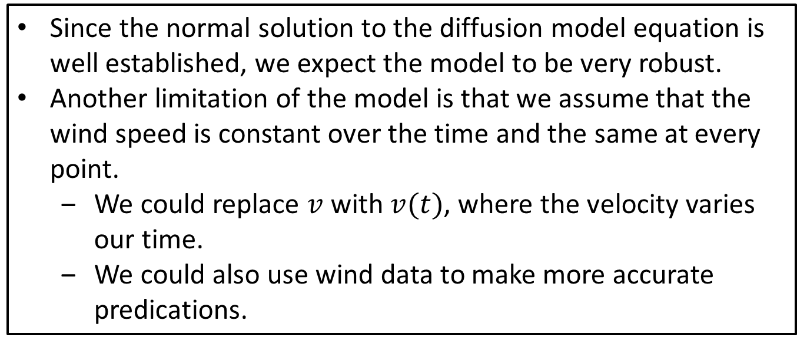
Robustness
Since the normal solution to the diffusion model equation is well established, we expect the model to be very robust.
Another limitation of the model is that we assume that the wind speed is constant over the time and the same at every point.
We could replace $v$ with $v(t)$, where the velocity varies our time.
We could also use wind data to make more accurate predications.

